Slide 1

Sandip Foundation’s
Sandip Institute of Technology and Research Centre (SITRC)
Department of Electronics and Telecommunication (E&TC) Engineering
Academic Year 2020-21
A
SEMINAR PRESENTATION
ON
Tomato Leaf Disease Detection Using Image Processing with help of Python.
By
Nilesh Dhepale (BE-A)
Kiran Sujgure (BE-A)
Harshal Patil (BE-A)
Guided By
Prof. Swati Pawar

Slide 2
INDEX
PROBLEM STATEMENT
LITERATURE SURVEY
BLOCK DIAGRAM
FLOWCHART
METHODOLOGY
PROPOSED SYSTEM
SOFTWARE USED
ADVANTAGES
APPLICATION
CONCLUSION
FUTURE SCOPE
REFERENCES

Slide 3
Introduction
Plant disease is major problem in today’s agriculture system, for prevention of disease we are going to develop a system that detect and identify the disease.
In this project, we will detect the disease using Image processing Technique and classification of disease by using classifier technique like CNN,K-Mean Clustering,SVM etc.
This project will we very useful for farmers to detect the disease in the initial stages of growth.

Slide 4
Problem Statement
Plant Leaf disease is major problem in today’s agriculture industry, by this project using Image processing methodology we are going to detect and identify leaf disease and it’s name, also providing preventive measure to farmers as per the disease.

Slide 5
Literature Survey
Sr.No | Reference Paper | Year of Publication | Author | Methodology | Outcome | Drawback
1. | Plant Leaf Disease Detection and Soil Condition Monitoring System Using CNN And IOT. | 2020 | Kaushik N, Nikhil K G, Sulagna Sarkar. | CNN,IOT | Diseases detection and Soil Condition Monitor. | Huge area soil monitoring is not possible.
2. | Plant Disease Detection with Deep Learning and Feature Extraction Using Plant Village | 2020 | Faye Mohameth, Chen Bing Cai1, Kane Amath Sada | Deep Learning ,Deep Feature Extraction | Using 3 DL models detection of the plant disease is done. | They not mentioned name of plant which is tested
3. | Detection And Identification Of Plant Leaf Diseases Based On Python. | 2020 | Mr. Ashish Nage, Prof. V.R. Raut. | Image processing, CNN. | Diseases detection on Python OpenCv Library. | Is limited for only single plant.
4. | Farmer Buddy-Web Based Cotton Leaf Disease Detection Using CNN. | 2019 | Shantanu Kumbhar, Amita Nilawar, Shruti Patil | Gray-Level Co-Occurrence Matrix,CNN | Classified into different diseases name . | Only two diseases have been reported

Slide 6
Sr.No | Reference Paper | Year | Author | Methodology | Outcome | Drawback
5. | Identification of Plant Disease using Image Processing Technique | 2019 | Abirami Devaraj, Karunya Rathan, Sarvepalli Jaahnavi and K Indira | Image Processing, Random Forest Classifier. | Outcome is Different type of disease name identified. | No drawback.
6. | Real-Time Detection of Apple Leaf Diseases Using Deep Learning Approach Based on Improved Convolutional Neural Networks | 2019 | Peng Jiang, Yuehan Chen, Bin Liu Dongjian He, And Chunquan Liang | DL,Improved CNN. | On apple leaf Rust,Mosaic, Brown spots disease etc disease identified. | Not given solution on this diseases prevention.
7. | Rice crop Disease Identification And Classifier. | 2019 | Vishakha Lahu Bansod | Image processing, SVM. | Accurate detection and classification of the plant disease. | Nil
8. | Fault Area Detection in Leaf Diseases using k-means Clustering | 2019 | Subhajit Maity, Sujan Sarkar, Avinaba Tapadar, Ayan Dutta, Sanket Biswas, Sayon Nayek, Pritam Saha | K-Mean clustering ,Image segmentation, Otsu’s method. | Grey spot disease identified on Rice crop . | Data Set

Slide 7
Objective
To Identify Plant Leaf disease detection.
To Identify the type of Disease and Classified into Different types.
To suggest the appropriate pesticide for Type of Disease.

Slide 8
Block Diagram
Test Leaf Image
Preprocessing
RGB TO HSV
conversion
Color And Texture Feature
Reference
Image
Feature Extraction
BPN-FF Training
Trained Network
(Classifier)
Decision

Slide 9
Flow chart
Image Acquisition
Image Preprocessing
Image Segmentation
Feature Extraction in Image
Detection and Classification
of plant disease

Slide 10
Methodology
Image Acquisition.
Image Preprocessing.
Segmentation.
Feature extraction.
Classification.

Slide 11
Proposed System
Preprocessed
Reference Images
Input
Disease
Affected
leaf
Contrast
Enhancement
OTSU
Segmentation
K-Mean
Clustering
Feature
Extraction
Trained
Network
Classifier
Train
Data
Classification
Of
Disease
Early
Blight
Bacterial
Spot
Iron
Chlorosis
Septoria
Leaf Spot

Slide 12
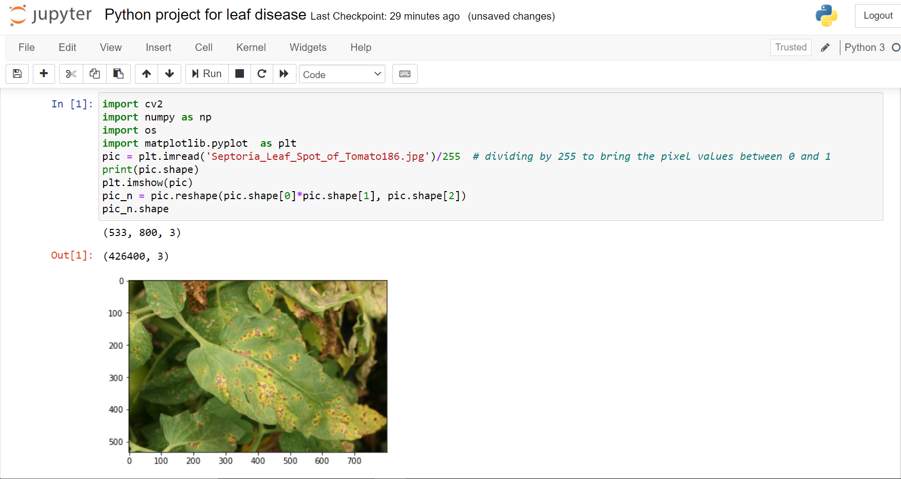
Step_1:-Input Disease Affected Leaf

Slide 13
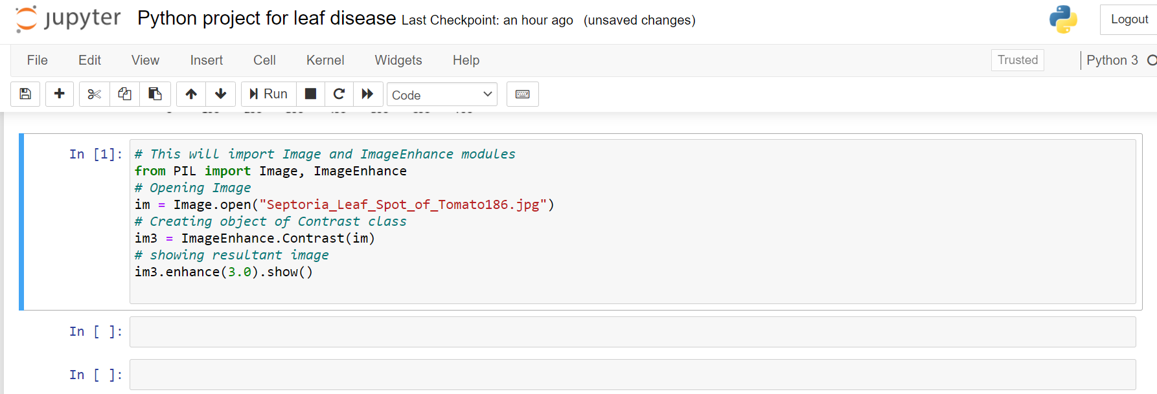
Step_2:-Contrast Enhancement

Slide 14
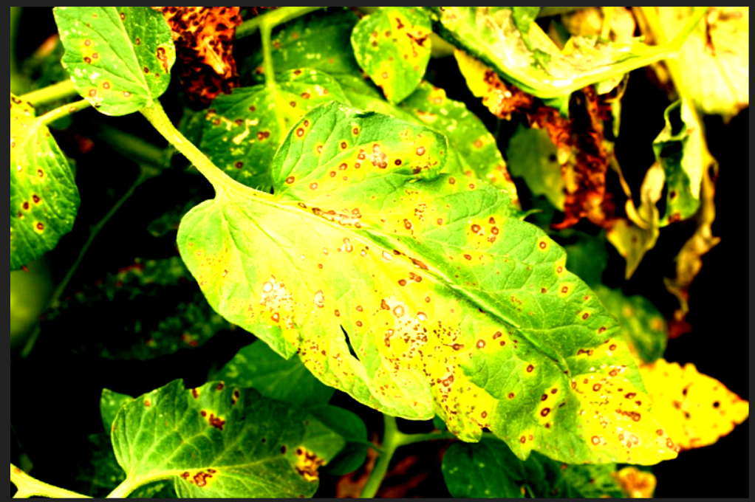
#Contrast Image (F=3.0)

Slide 15
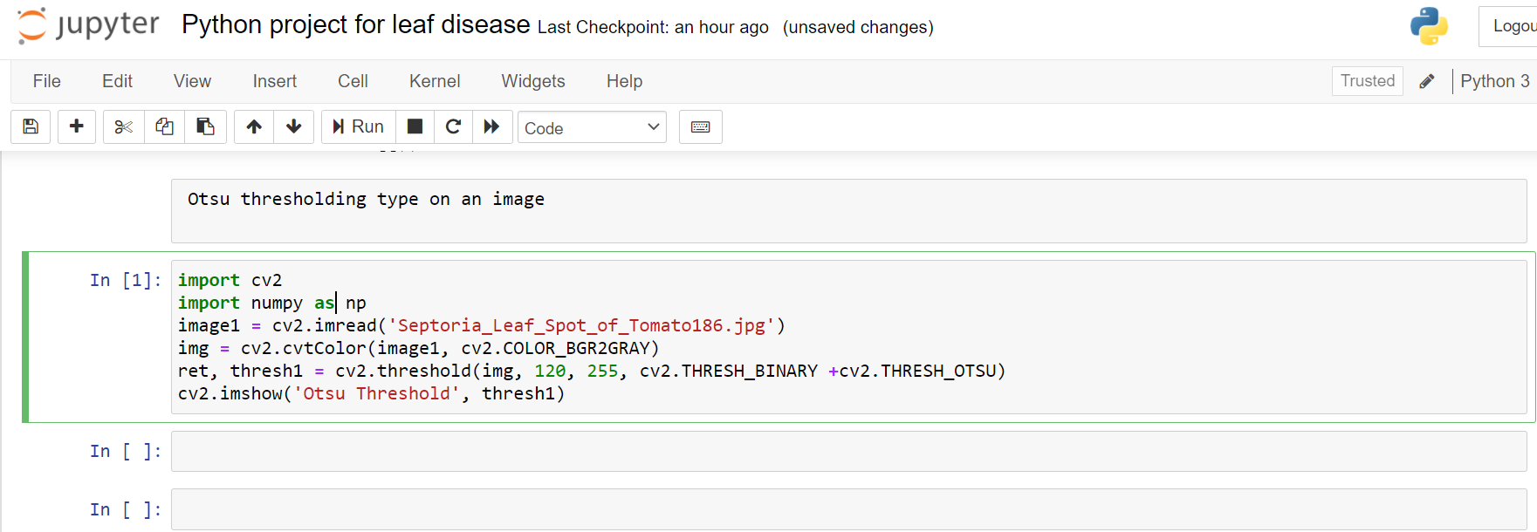
Step_3:- Otsu Segmentation

Slide 16
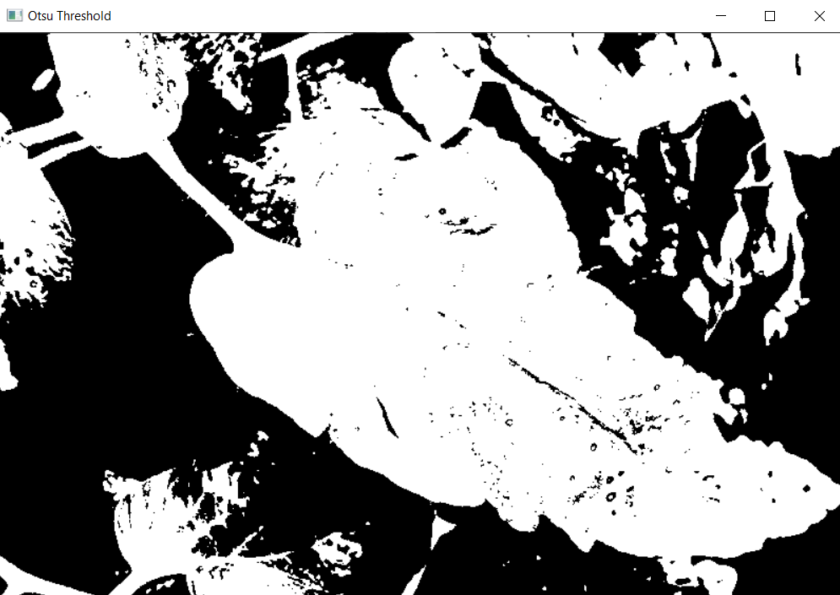
#Otsu thresholding type on an image.

Slide 17
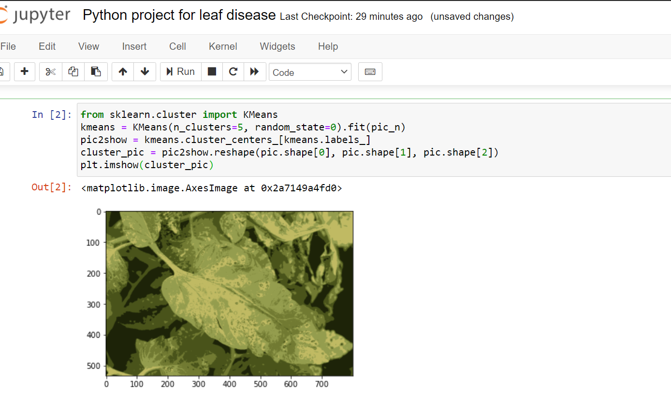
Step_4: K-Meanclustering

Slide 18
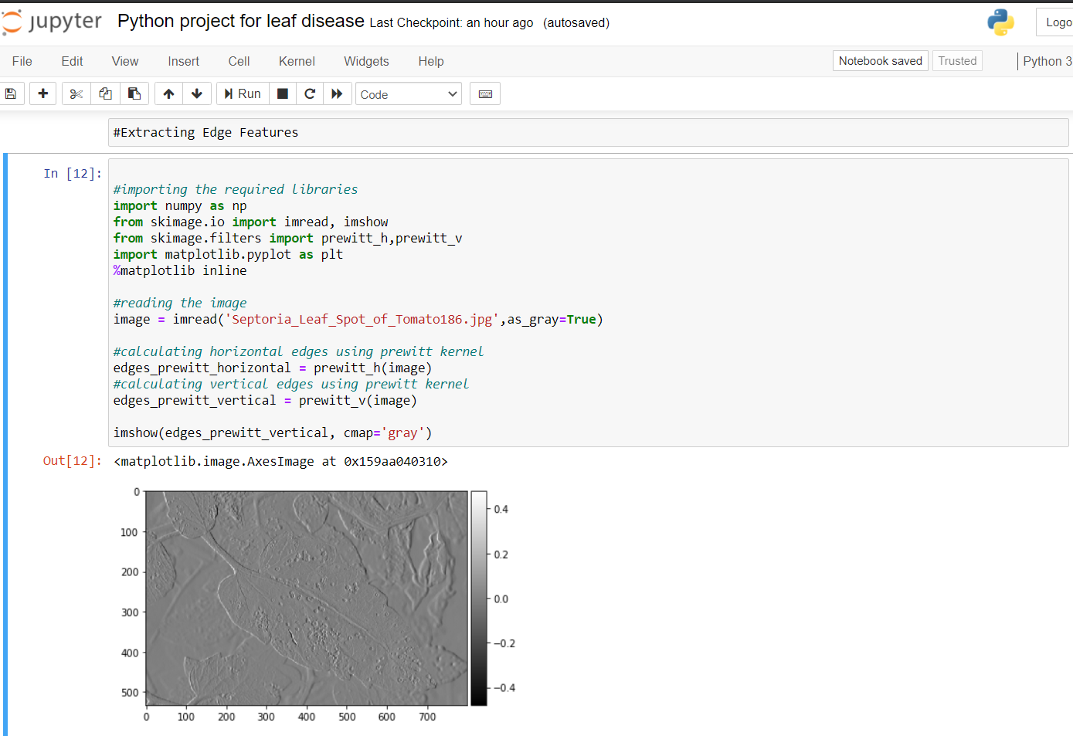
Step_5: Feature Extraction

Slide 19
Software
This project based on Python language. It easy to use in Image Processing. In Python OpenCV , Numpy , Matplotlib , K-mean library is to be installed. It is one of the Libraries used for the image processing in python.

Slide 20
Advantages
Our project help to farmers to know the disease in its initial stage, so they can use pesticides and take control on disease .
It also increases the production of good quality agriculture product .
To improve the yield of plants, it is necessary to detect the onset of diseases in plants and advice the farmers to act based on the suggestions.

Slide 21
Application
Plant disease detection is one of the important for agricultural applications to increase the yield.
Also Use to monitoring Flower and Fruit Garden.

Slide 22
Conclusion
In this project we are trying to help farmers to identify leaf disease. Here we have select tomato leaf to identify disease. also in this project we are going to develop mobile application for the farmer where they will get notification regarding disease on leaf, also we can suggest them pesticide for that identified disease.

Slide 23
Future Scope
In future we will try to implement this project with the help of either CNN , SVM , etc algorithms.
Also we will design a mobile application for this project.

Slide 24
Reference
[1] | Kaushik N, Nikhil K G, Sulagna Sarkar, “Plant Leaf Disease Detection And Soil Condition Monitoring System Using CNN And IOT “ 2020 Journal Of Xi'an University Of Architecture Technology,Volume Xii, Issue Vi, ISSN No : 1006-7930.
[2] | Faye Mohameth, Chen Bingcai, Kane Amath Sada, “Plant Disease Detection With Deep Learning And Feature Extraction Using Plant Village” Journal Of Computer And Communications, Doi: 10.4236/JCC.2020.86002 Jun. 17, 2020.
[3] | Mr. Ashish Nage, Prof. V.R. Raut,“ Detection And Identification Of Plant Leaf Diseases Based On Python”,2019 International Journal Of Engineering Research & Technology (IJERT) ISSN: 2278-0181 IJERT is 050180 Vol. 8 Issue 05.

Slide 25
[4] | Shantanu Kumbhar, Amita Nilawar, Shruti Patil,” Farmer Buddy-Web Based Cotton Leaf Disease Detection Using Cnn” ,2019 International Journal Of Applied Engineering Research Issn 0973-4562 Volume 14, Pp.2662-2666.
[5] | Abirami Devaraj, Karunya Rathan, Sarvepalli Jaahnavi And K Indira, “Identification of Plant Disease Using Image Processing Technique” International Conference on Communication and Signal Processing, India, 978-1-5386-7595-3/1 April 4- 6, 2019
[6] | Peng Jiang, Yuehan Chen, Bin Liu Dongjian He, And Chunquan Liang, “Real-Time Detection Of Appl Leaf Diseases Using Deep Learning Approach Based On Improved Convolutional Neural Networks”, IEEE, Volume 7, 2019.
[7] | Vishakha Lahu Bansod, “Rice crop Disease Identification And Classifier”, 2019 International Journal Of Computer Science And Engineering, Vol.-7,Special Issue-11.

Slide 26
Thank you !

